Slide 1



Network Analysis
MADRID METRO
Group B

Slide 2


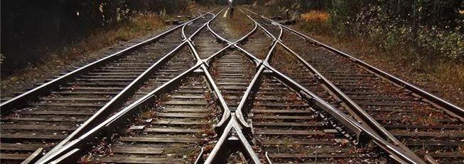
NODES
EDGES
STATIONS
RAILWAYS
ATTRIBUTES
ATTRIBUTES
Station name
Number of entries and exits
Number of lines
Coordinates
Line Number
Number of Coaches

Slide 3
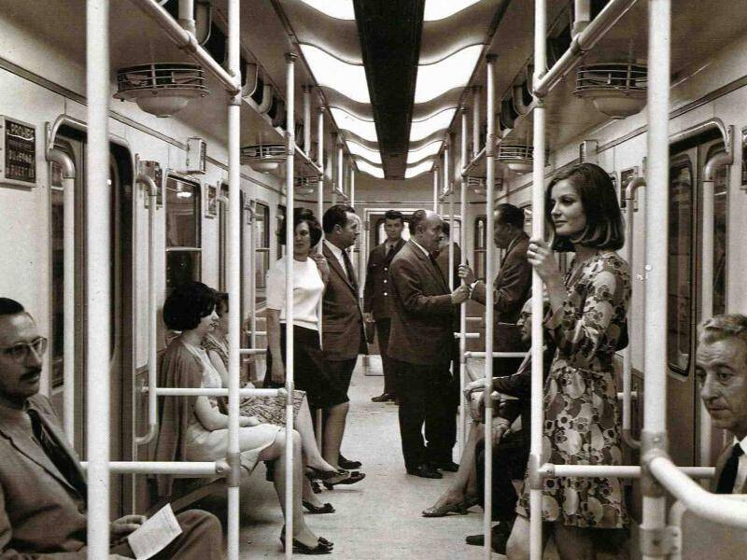

CONNECTED
2. EFFICIENT
Coverage vs Expense
THE IDEAL METRO NETWORK

Slide 4
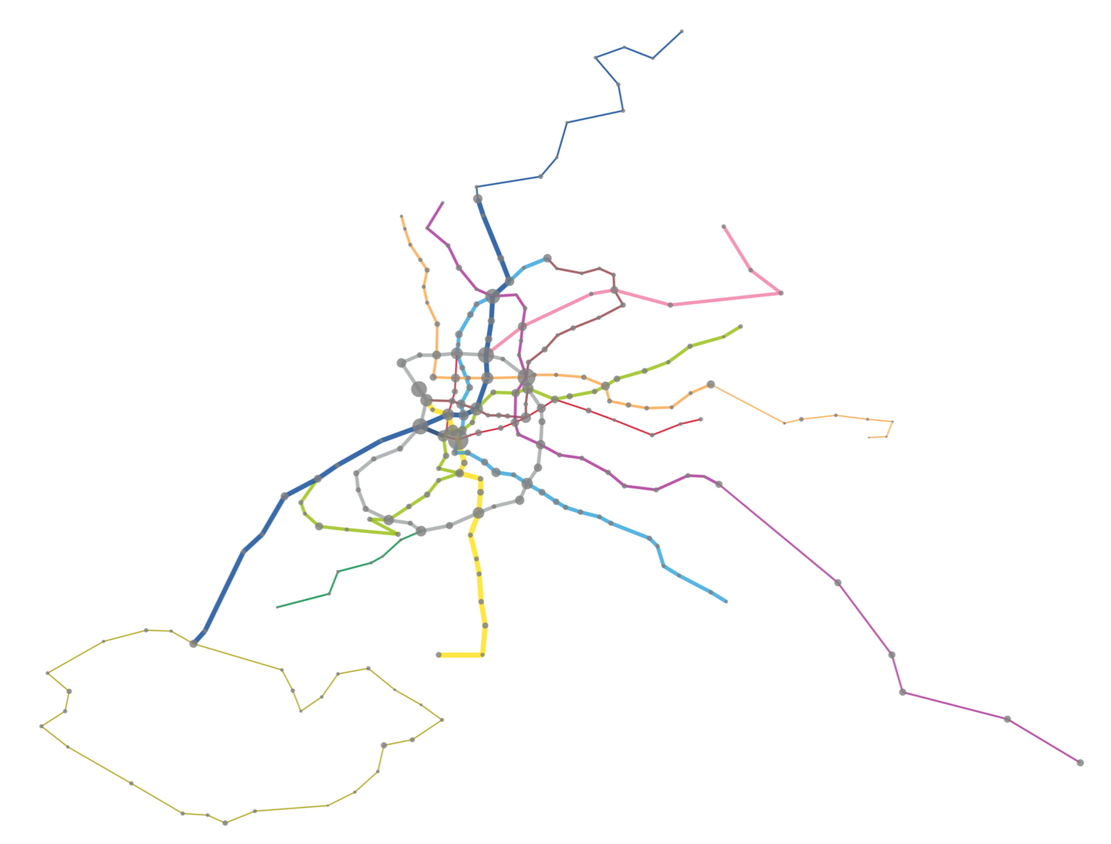
MADRID METRO
Colour: Line
Width: Capacity
Node Size: Entries + Exits

Slide 5
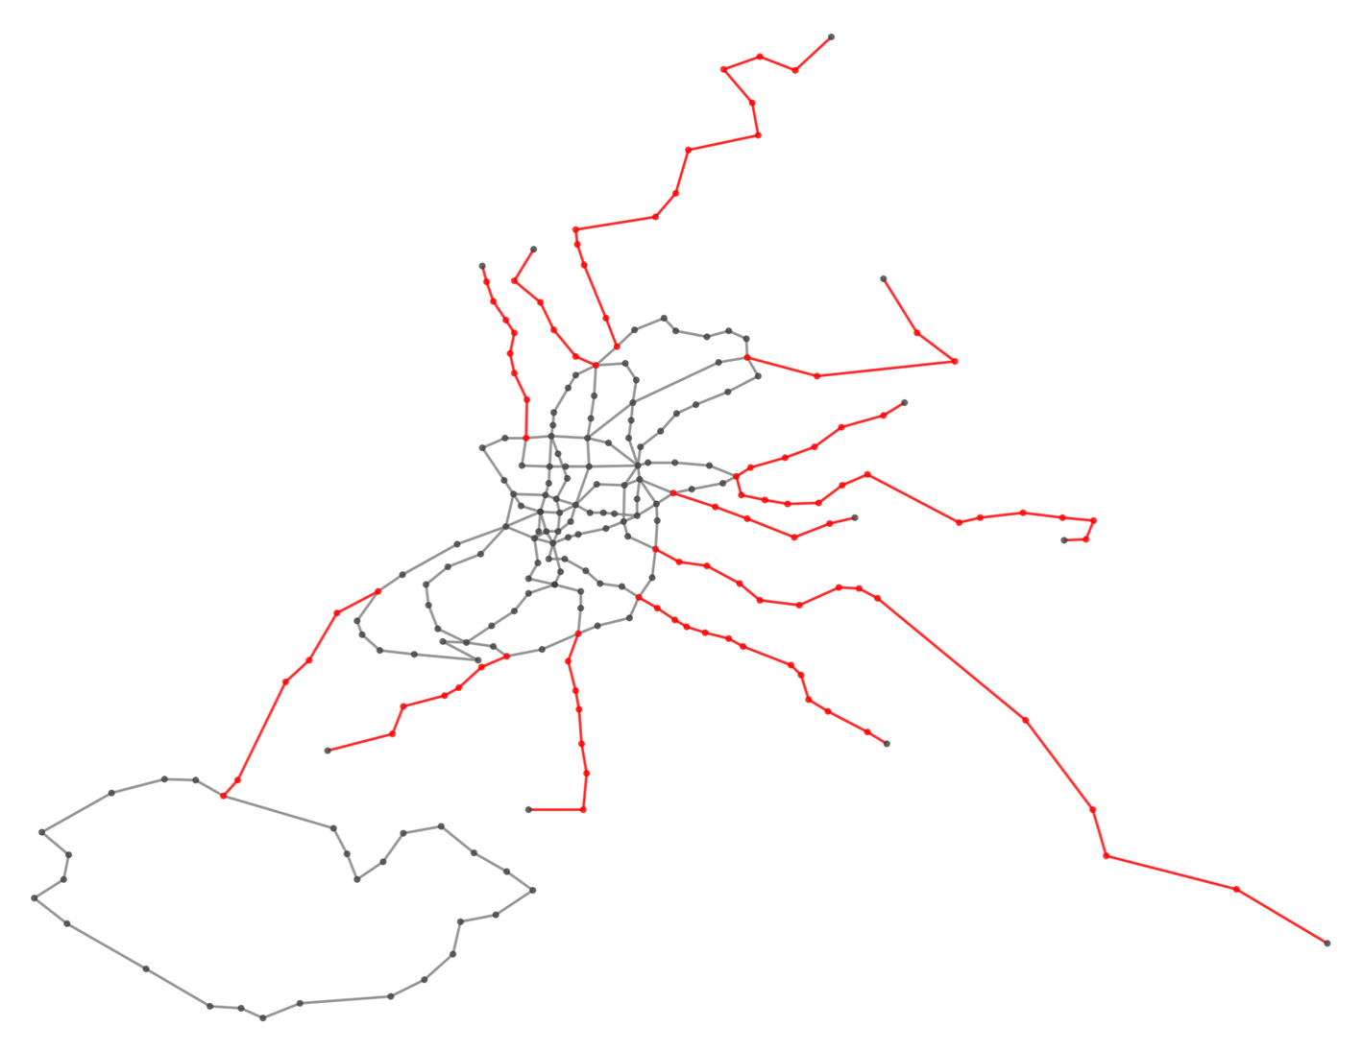

97
ARTICULATION NODES
97
BRIDGE EDGES

Slide 6
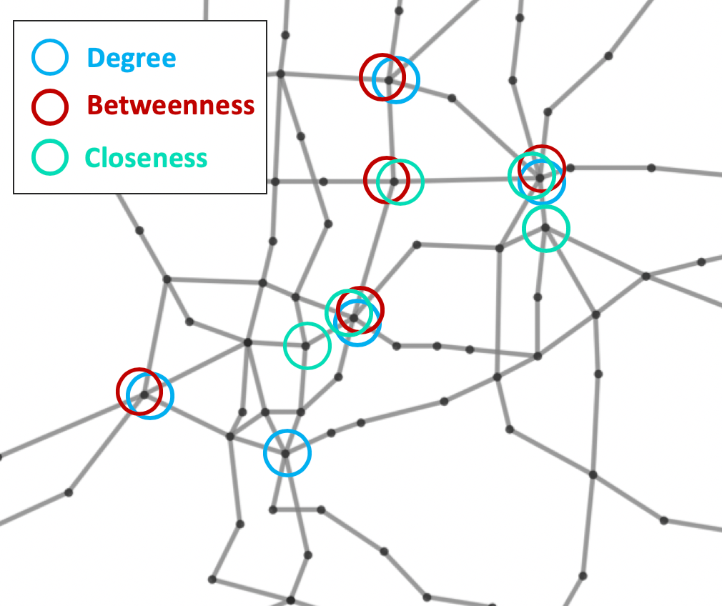
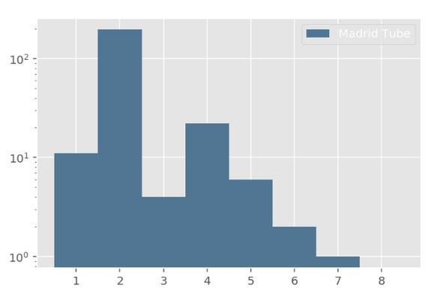
Nuevos Ministerios
CENTRALITY
Gregorio Marañón
Avenida de América
DEGREE DISTRIBUTION
Diego de León
Alonso Martínez
Tribunal
Príncipe Pío
Sol

